Slide 1
Hinglish Sentiment Analysis
Sarthak Pokale -16010122146
Khushi Poojari -16010122147
Hyder Presswala - 16010122151
Vedant Rathi-16010122154
Faculty Advisor - Prof Veena Badgujar
K.J Somaiya School of Engineering
Department of Computer Engineering

Slide 2
Introduction
Hinglish refers to code-mixed Hindi-English text (Hindi words written in Latin script mixed with English). It is extremely common on Indian social media, with studies finding ~86% of sampled tweets contain Hinglish content.
Example: “ye movie bahut acchi hai” (Hinglish sentence mixing Hindi and English).
Importance: Hinglish posts dominate user-generated content in India and diaspora. Accurately analyzing their sentiment is crucial for opinion mining and business intelligence in this large market.

Slide 3
Problem Statement
Challenge: Standard sentiment models assume monolingual text. Hinglish violates this by mixing grammar, script and vocabulary, making ML difficult. Code-mixing leads to noisy spelling (e.g. “salaam alaikum” vs “salaam alaikum”) and ambiguous tokens.
Consequences: Off-the-shelf monolingual classifiers perform poorly on Hinglish, misinterpreting sentiment or failing to assign neutral/positive labels correctly. This hinders social media monitoring and opinion analysis in the Indian context.

Slide 4
Motivation & Contributions
Most existing sentiment analysis systems are designed for English-only text and perform poorly on Hindi–English code-mixed (Hinglish) tweets.
Hinglish sentiment analysis is challenging due to lack of grammatical structure, spelling variations, language ambiguity, and negation handling issues.
This project proposes a bilingual sentiment analysis system specifically for Hinglish Twitter data.
An effective preprocessing and feature extraction pipeline is applied to clean and normalize the data.
A translation-based approach is used to handle bilingual words and resolve language ambiguity.
Multiple machine learning classifiers are trained and evaluated for sentiment prediction.
A voting-based ensemble model combines the strengths of individual classifiers, resulting in improved sentiment classification accuracy.

Slide 5
Objectives:
1. To develop a bilingual sentiment analysis system capable of classifying Hindi–English code-mixed (Hinglish) tweets as positive or negative.
2. To preprocess and normalize noisy Twitter data by handling spelling variations, negation, and bilingual vocabulary.
3. To extract sentiment-bearing linguistic features such as adjectives, adverbs, and abstract nouns for effective classification.
4. To train and evaluate multiple machine learning classifiers on Hinglish data.
5. To design a voting-based hybrid ensemble model that improves sentiment prediction accuracy compared to individual classifiers.

Slide 6
Literature Survey
Paper (Year) | Methodology | Dataset | Advantages | Limitations
Joshi et al. (2016) | Subword-LSTM: Learn sub-word (morpheme) embeddings in an LSTM for Hi-En code-mix. | Introduced a new Hindi-English tweet dataset for sentiment. | + Improves over character/word LSTM by ~5% (accuracy); robust to noisy spelling. | – No usage of modern transformers or attention; dataset size limited.
Lal et al. (2019) | Dual-Encoder CNN/BiLSTM: CNN extracts sub-word features; two BiLSTM (“Collective” + “Specific” with attention) + feature network. | Benchmark Hinglish sentiment dataset (from prior works). | + Achieved SOTA: 83.5% accuracy, F1=0.827; handles multi-sentiment clauses (e.g., “X but Y”). | – Complex architecture with many components; specific to their dataset.
Singh & Lefever (2020) | Cross-lingual embeddings: Train monolingual and bilingual word embeddings; use them in SVM classifier and transfer learning. | Large Twitter collection (English + Hinglish). | + Cross-lingual embeddings improved F1 from 0.616 to 0.635 without parallel data; enables zero-shot transfer between languages. | – Overall F1 still modest (0.635); relies on large unlabeled corpora.
Bhange & Kasliwal (2020) | Fine-tuned Transformers: Compare NB-SVM, ULMFiT, RoBERTa and ensemble on SemEval-2020 Sentimix. | SemEval 2020 Task 9: ~17k Hinglish tweets (14k train, 3k test). | + Best F1=0.707 from a majority-vote ensemble; showed NB-SVM (classical) outperforms RoBERTa (6.2% F1 higher). | – Surprisingly, larger models underperformed, likely due to limited labeled data. RoBERTa was not specialized for Hinglish.
Hegde & Shashirekha (2024) | Multitask Transformers: Pre-trained Hinglish-BERT fine-tuned for fake/hate detection. Uses ensemble of Hinglish-BERT and Multilingual DistilBERT in MTL. | ICON 2024 Faux-Hate shared task (Hinglish Facebook comments). | + Hinglish-BERT (pre-trained on code-mix) captures nuance. Ensemble MTL achieved high macro-F1 (0.7589 on fake/hate). | – Focused on fake/hate detection, not pure sentiment. Hinglish-BERT pretrained on limited domains.
Kumar et al. (2025) | XLM-R + FNet/FastFormer: Enhance XLM-RoBERTa by integrating Fourier/FNet and FastFormer layers for sentiment+emotion. | SentiMix dataset (from Patwa 2020). | + Improved accuracy/F1 over vanilla XLMR on sentiment+emotion. Leverages frequency-domain features for subtle emotions. | – Very heavy models; evaluated only on one benchmark. Complexity may limit practical use.

Slide 7
Research Gaps
Limited data: Existing Hinglish sentiment corpora are small (e.g. ~17k tweets). More diverse domains (reviews, news comments) are needed.
Model shortcomings: Pretrained multilingual LMs (mBERT, XLM-R) “often falter” on code-mixed text since they were trained on monolingual corpora. Capturing mixed-language context remains hard.
Linguistic challenges: Handling negation, sarcasm, idioms and regional slang in Hinglish is underexplored. Most studies focus on coarse polarity (pos/neg/neu).
Resource imbalance: Hindi and Hinglish NLP tools (tokenizers, lexicons) are scarce compared to English. Research on robust transliteration and language identification is needed.

Slide 8
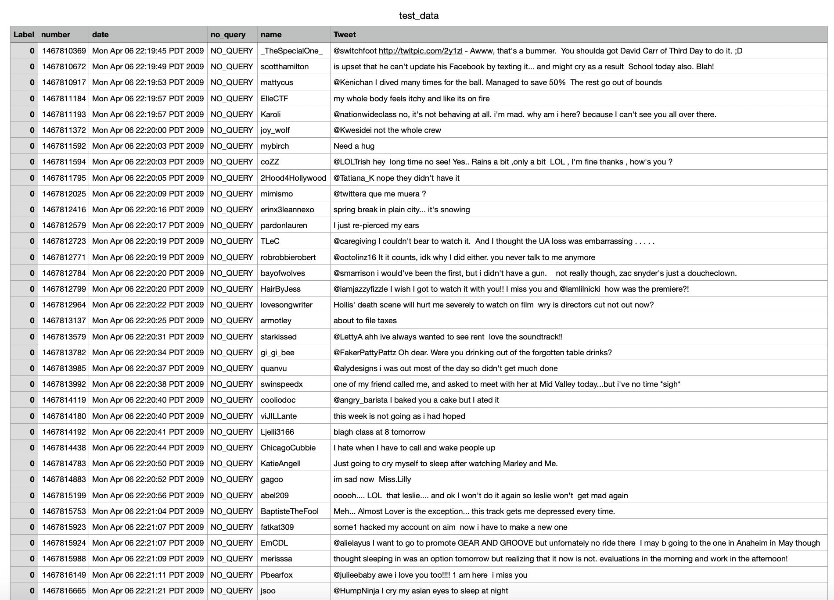
DataSet
The dataset that was used was obtained from “Kaggle” called the Sentiment140 dataset. The dataset snpashot has been attached below for reference -
It contains 16,00,000 tweets extracted using the twitter API. The tweets have been annotated (0 = negative, 2 = neutral, 4 = positive) and they can be used to detect sentiment. But only 40000 rows where randomly selected from this dataset, with equal distribution of positive and negative tweets, i.e. neutral tweets were ignored as this study focuses on binary classification.

Slide 9
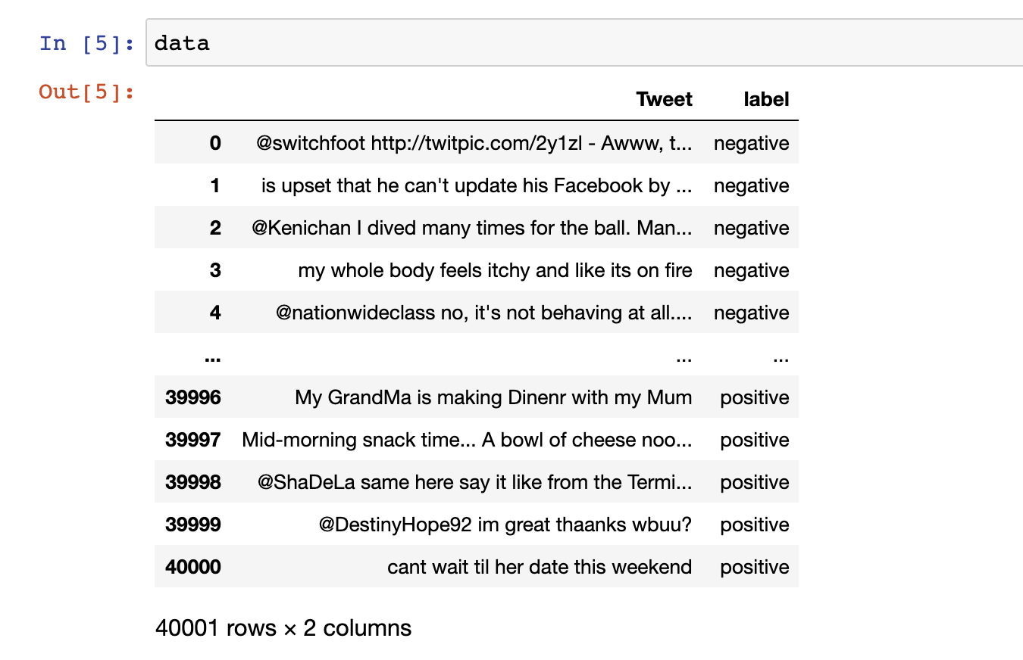
Preprocessing
First, only a handful of columns were used from the set of 6 columns. These columns used were Tweet and Label. The remaining columns were discarded as they were not needed.

Slide 10
2. Next, any HTML tags present in the text were removed with the help of BeautifulSoup package. Quotation marks ( ‘, “) and URLs were removed as they are unnecessary for the sentiment analysis of the text. If any emoticons were used in the tweet, they were converted into their equivalent emotion that they are intended to signify, and the emojis were removed.
3. Then, all the words in the text are converted to lower case and repeating words in the same tweet are removed.
4. Concatenated words, i.e. words which were joined such as “Can’t” were expanded to “Can not”.
5. The data cleaning process also included the removal of punctuations, numbers, special characters and user handles or tags (“@” symbol followed by the account handle). Stopwords, other than ‘not’ and the word ‘is’ were also removed from the text.
6. The cleaned tweet contained corrected spellings of all words, because of the use of the ‘SpellChecker’ package. All words with length equal to one were also removed.

Slide 11
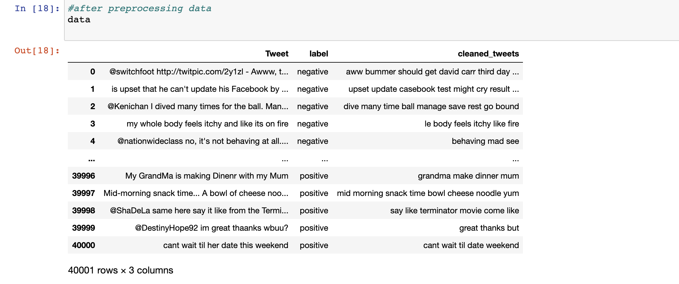

Slide 12
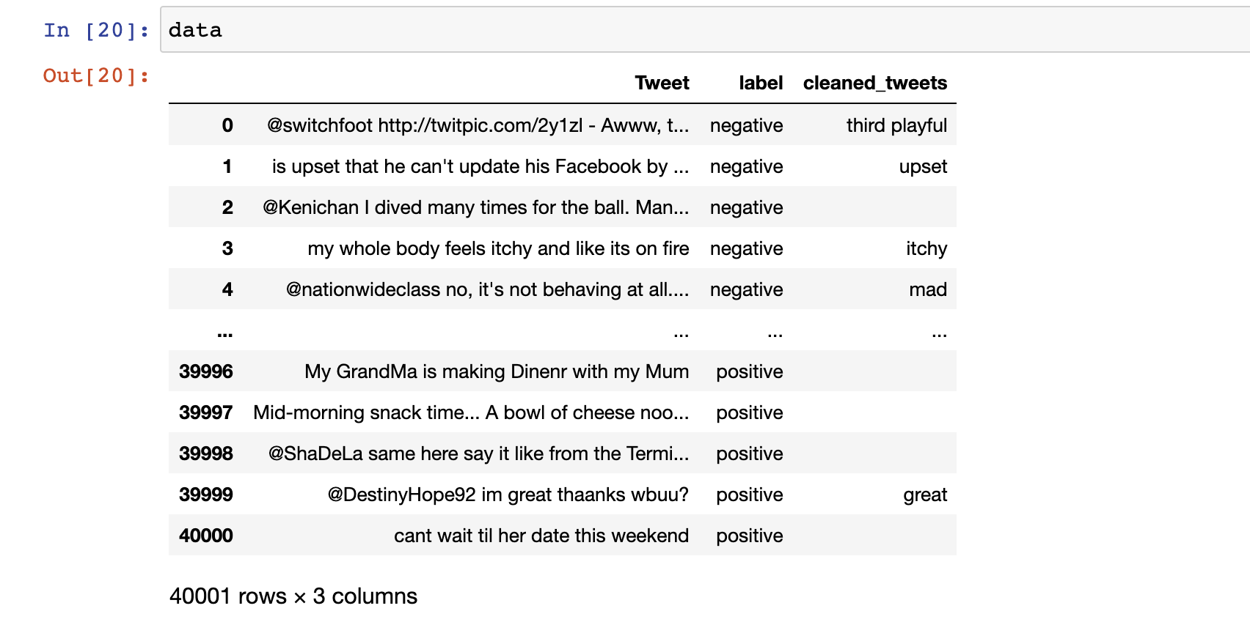
7. Next, the words were lemmatized, and words preceded by ‘not’ were substituted by their antonyms to represent the negation effect. Finally, the dataset contained the cleaned tweets
8. This dataset has three columns, namely Tweet, Label and cleaned_tweets. The first two are the ones taken from the original dataset. The last column is a derived column from all the preprocessing and contains just the features extracted from each of the tweet texts, as string.

Slide 13
Feature Extraction
Only certain words such as adjectives, adverbs, and abstract nouns were kept because they contribute most to sentiment. All other words were removed. For feature extraction, each cleaned tweet was checked against a predefined list containing common adjectives, adverbs, and abstract nouns. Words found in this list were selected as features, while the rest were discarded. The selected features for each tweet were stored in a separate column. This approach was used because existing methods, such as NLTK’s pos_tag, are outdated and sometimes inaccurate for example, the word “clever” is incorrectly tagged as a noun.

Slide 14
Methodology
Dataset Collection and Selection
A labelled Twitter dataset (Sentiment140) is used, from which 40,000 tweets are randomly selected with an equal distribution of positive and negative classes.
Data Preprocessing
The tweets are cleaned by removing noise such as URLs, HTML tags, emojis, and user mentions. Text normalization steps including lowercasing, spell correction, lemmatization, stopword removal (with negation handling), and contraction expansion are applied.
Feature Extraction
Sentiment-rich features such as adjectives, adverbs, and abstract nouns are extracted using a predefined linguistic dictionary to retain only emotionally significant words.
Bilingual Text Handling
A translation-based mechanism is implemented using TextBlob and Google Translator to detect Hindi words written in Latin script and convert them into English, resolving language ambiguity.
Model Training
The processed dataset is split into training (85%) and testing (15%). Seven classical machine learning classifiers are trained independently on the training data.
Ensemble Model Construction
A voting-based ensemble model is created by combining the predictions of all classifiers to improve robustness and accuracy.
Evaluation
The performance of individual classifiers and the ensemble model is evaluated using accuracy, precision, recall, F1-score, and confusion matrix analysis.

Slide 15
Results
The performance of all individual classifiers is evaluated using accuracy, precision, recall, and F1-score. Experimental results show that while individual classifiers perform reasonably well, their predictions vary due to differences in learning behavior.
The voting-based hybrid ensemble model achieves the highest accuracy among all models by combining the strengths of individual classifiers and reducing bias and variance. The confusion matrix analysis further confirms improved classification balance for both positive and negative classes. These results demonstrate that ensemble learning is an effective approach for bilingual Hinglish sentiment analysis.

Slide 16
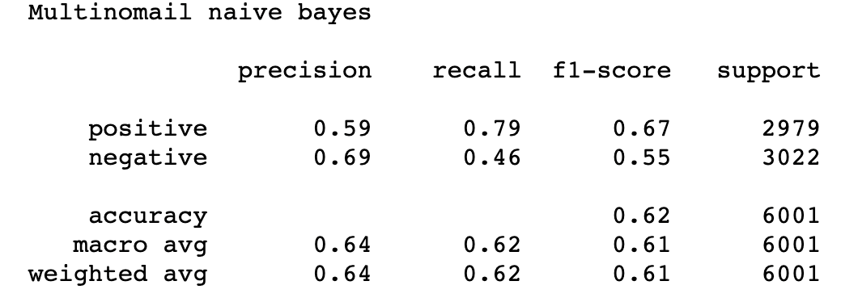
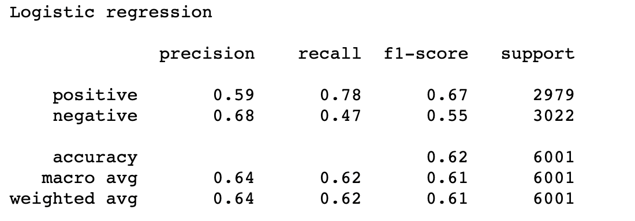
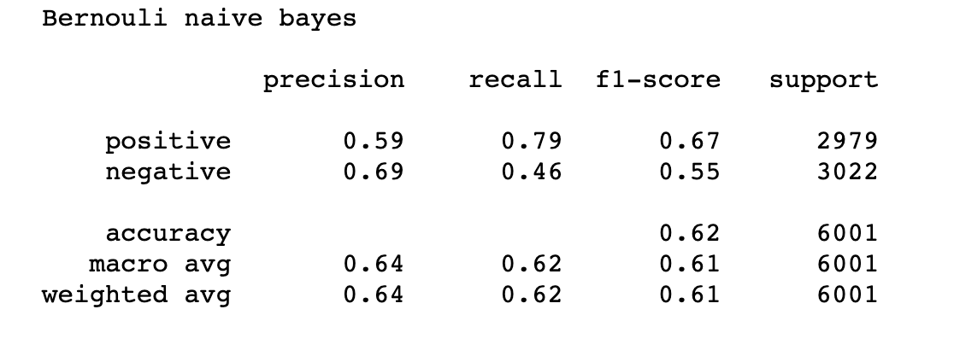
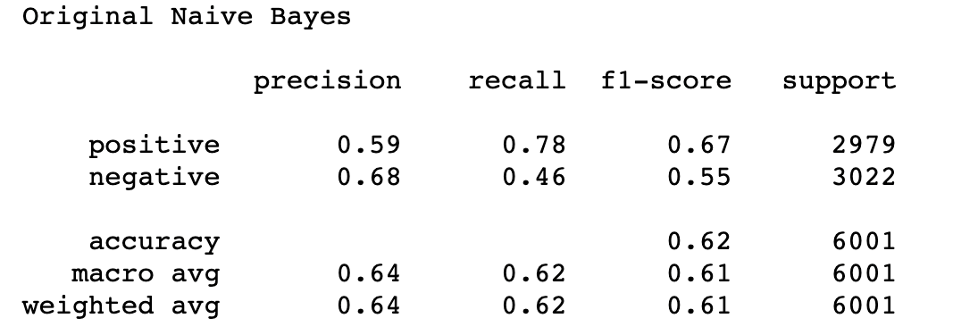
Performance

Slide 17
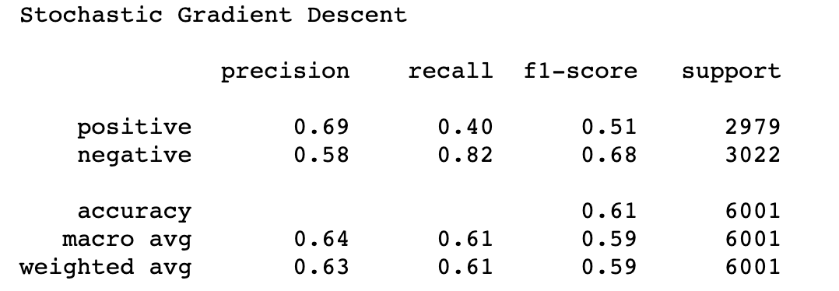
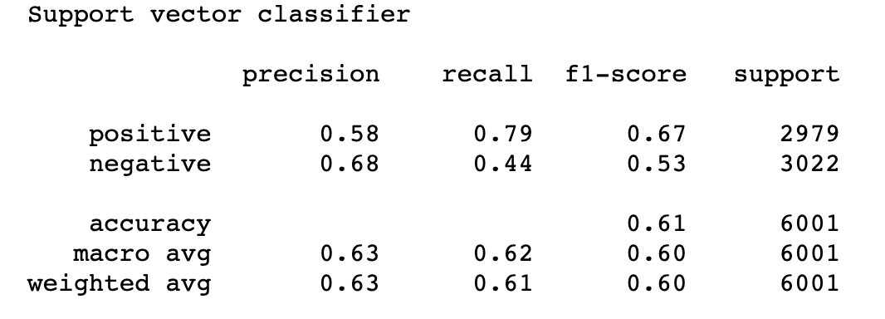
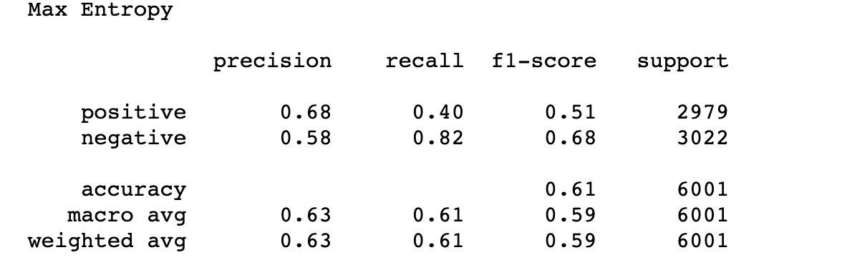
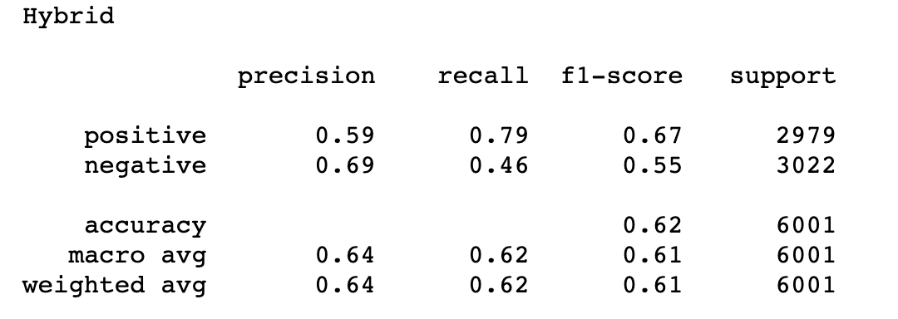

Slide 18
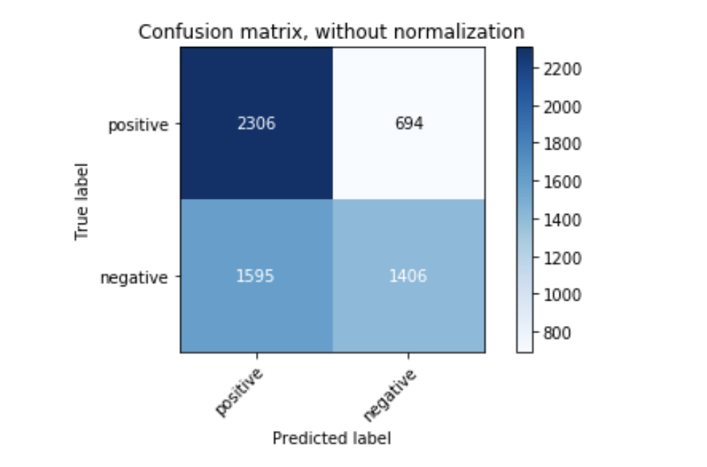
Confusion Matrix
Confusion Matrix before normalization (Trained Data)

Slide 19
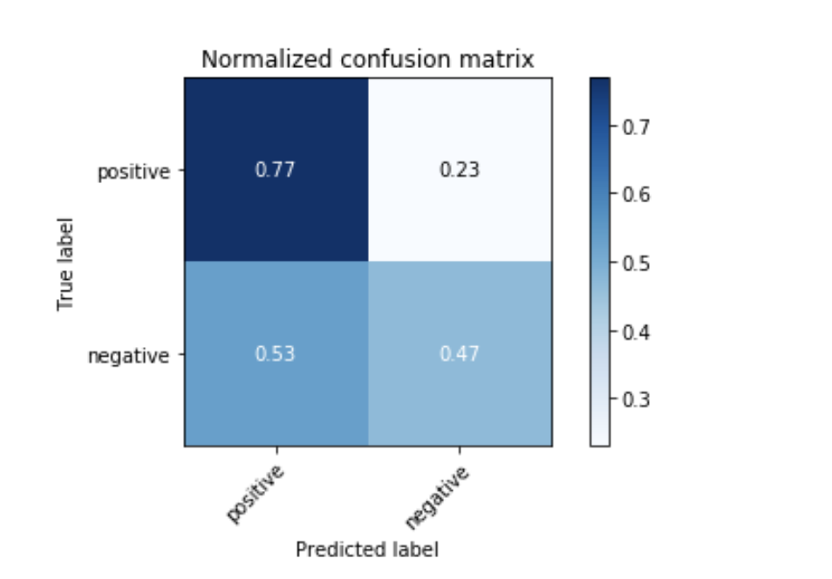
Confusion Matrix before normalization (Trained Data)

Slide 20
Future Work
Larger & Diverse Data: Collect more annotated Hinglish data from different domains (product reviews, news comments) and dialects. Multi-class emotion labels (joy, anger, etc.) would enrich analysis.
Better Models: Explore multilingual transformers fine-tuned with code-mixed objectives (e.g. extended pretraining on Roman Hindi). Investigate lightweight models for efficiency.
Contextual Understanding: Incorporate context (reply threads, user metadata) and sarcasm/idiom detection specifically for Indian languages.
Interactive Systems: Develop sentiment tools that allow users to highlight code-switching patterns, and continually adapt to new slang and spelling.
Multimodal Signals: Many Hinglish posts include emojis, images, or hashtags. Future systems can fuse text with these signals for better sentiment inference.

Slide 21
Thank You!

